Slide 1
WGH PROJECT:
Hazard Mapping for Sediment-related Disasters
Duration: 2009-2011
Participating members are Six members.
China
Hongkong China
The Philippines
Thailand
United States
Japan

Slide 2
Collaboration meeting between WGDRR and WGH
and
Field Training
for “Hazard Mapping for Sediment-related Disaster”
Schedule of Field Training
September 4 Indoor Lecture for TC members
September 5 Field Training for TC members and Local people
in model site of Zhuhai city
- TC member Group (Hayashi, Miyake Group)
Field Training
- Local people Group (Hiruma, Kamoto Group)
Indoor Lecture and Field Training

Slide 3
Road map
1st year (2009)
  Japan will distribute a draft of guideline and opens THD.
  Members select model sites.
2nd year (2010)
  Field training
  Members draw hazardous area in the model sites.
  Discuss technical problems at WS.
3rd year (2011)
  Members make Hazard map that will register in the guideline to reduce damage of sediment‐related disaster.
  Publish the guideline to reduce damage of sediment-related disaster and to spread Japanese technique in Typhoon Committee Region.

Slide 4
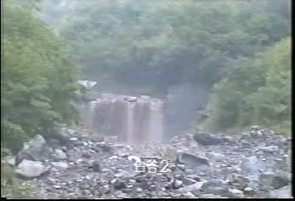
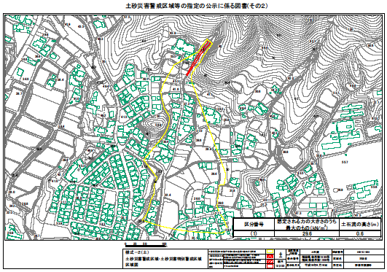
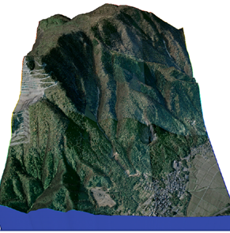
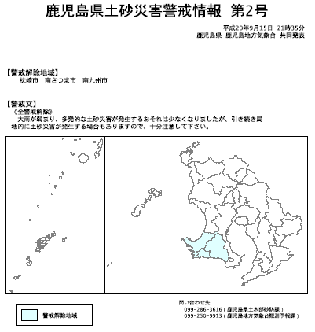
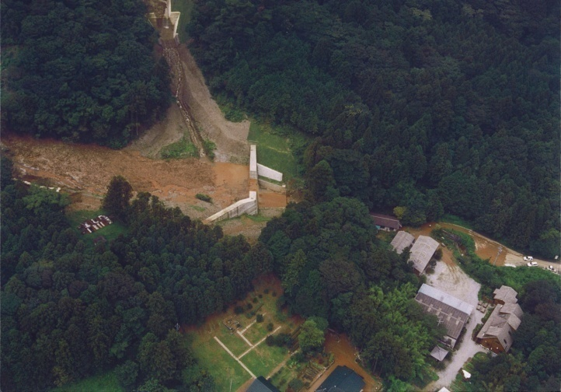
Strategy for reducing sediment-related disaster risk
Case study in Japan
Gorge
- Land-use restriction
Hazard (Debris flow)
-Land use control-
Check dam
Sediment disaster warning information
Houses
-Early warning
Non-structural measure
(Sediment Disaster Prevention Law)
- Check dam construction –
Structural measure
(Sabo Law)

Slide 5
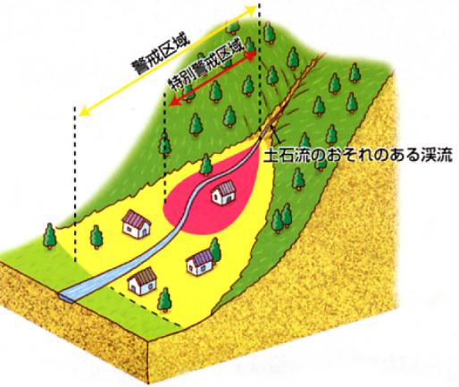
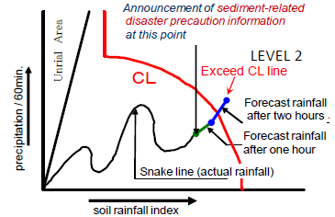
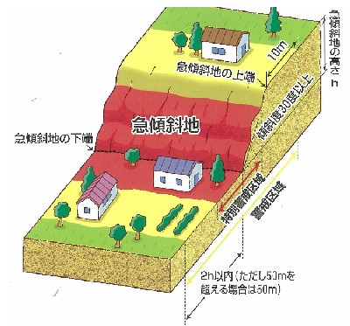
Proposes of Hazard Map are
Land use restrict
To Inform Early Warning Information for residents who live in hazardous area to evacuate
② Inform Early Warning Information
for residents who live in hazardous area
①Early Warning
③Evacuation

Slide 6
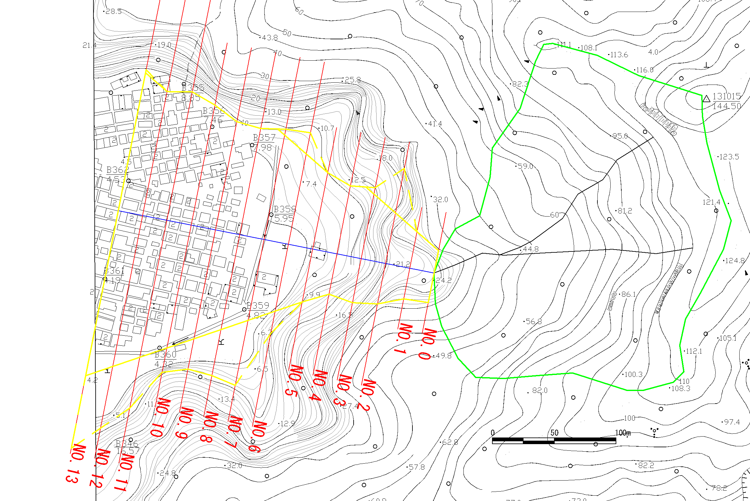
In hazardous Area,
There is possibility that residents die.
It is necessary to evacuate.
The direction of debris flow is unknown.
Debris flow doesn’t spread all Hazardous area.
60°

Slide 7
What’s Hazard Map?
Map which guides residents to evacuate safely
② Inform Early Warning Information
for residents who live in hazardous area
①Early Warning
③Evacuation
Hazard Map guides
residents to evacuate safely
Essential information
- Hazardous Area
Evacuation route, refuge
- Explanation about risk

Slide 8
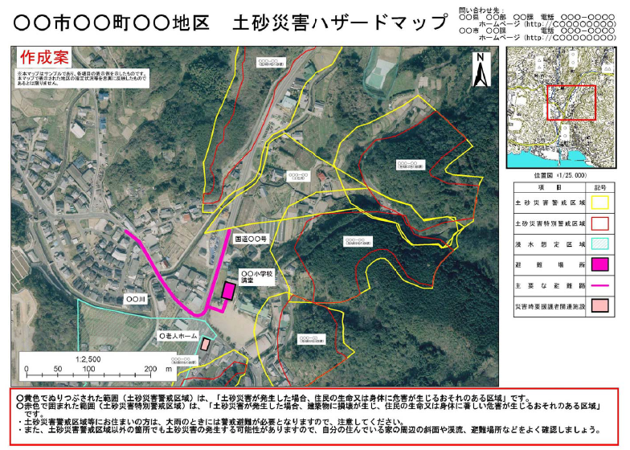
Japanese example 1 (Photo ver.)
Hazardous Area
Evacuation
route and refuge
Explanation about risk

Slide 9
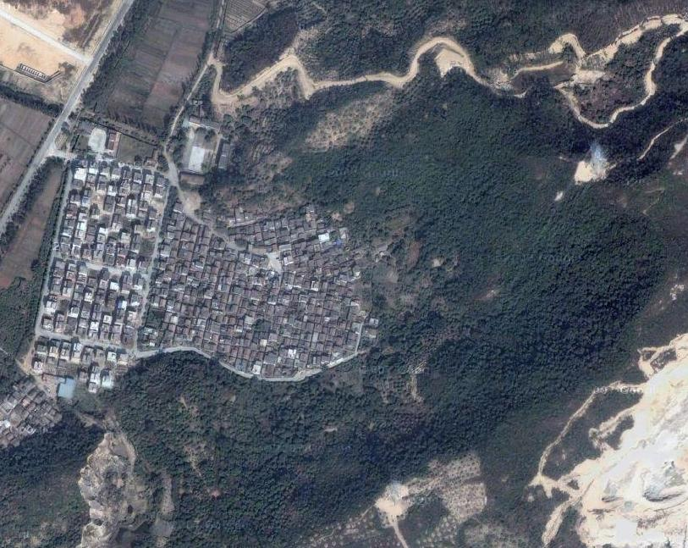
Example of Hazard Map:
○○ village Hazard map for sediment-related disaster
Refuge:
Elementary School
Evacuation route
Notice:
Yellow zone is a high risk area for debris flow.
If It has inexperienced heavy rain, be careful and evacuate.
100m

Slide 10
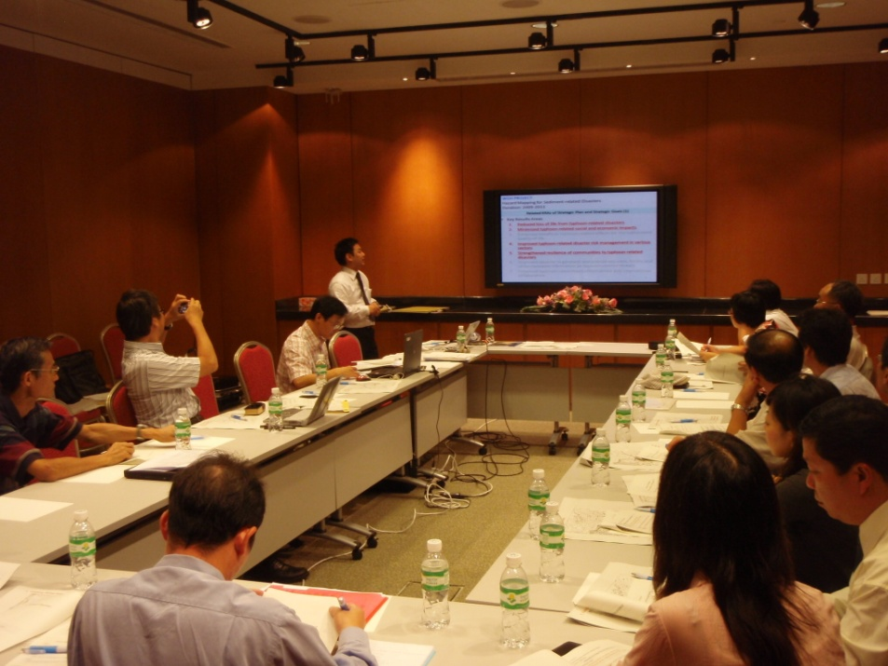
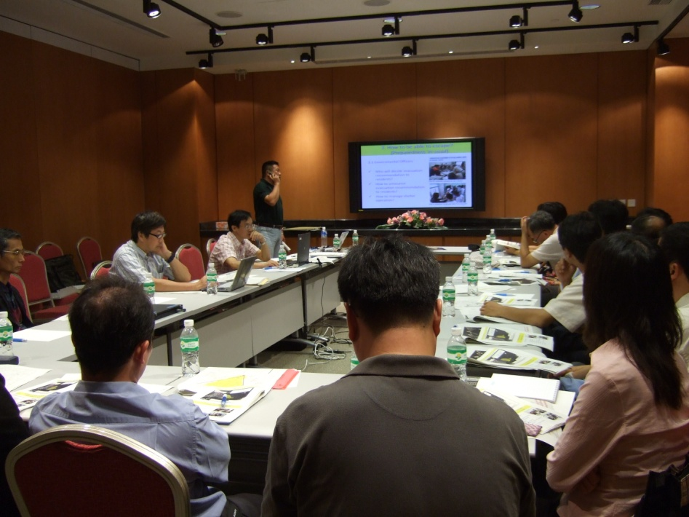
September 4 Indoor Lecture

Slide 11
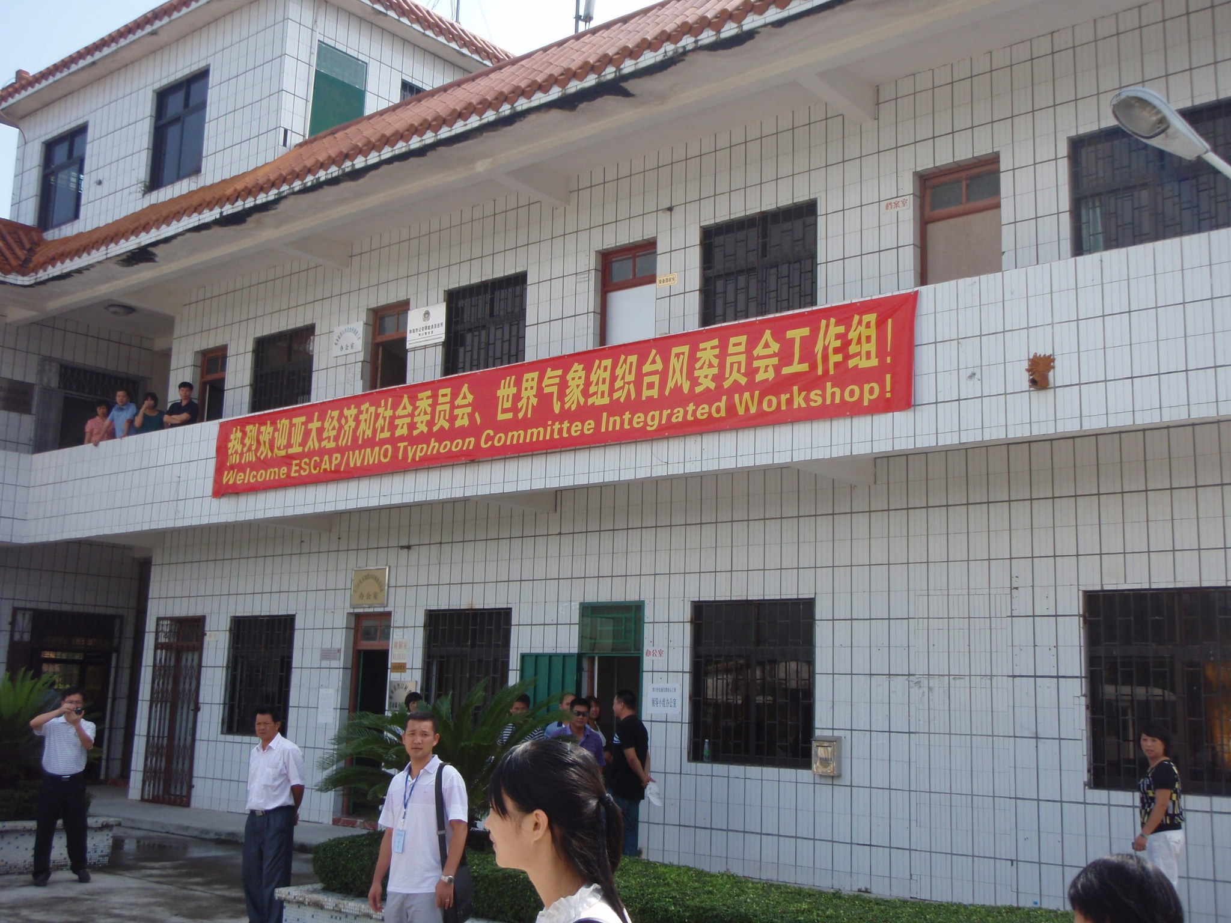
September 5
Field Training for TC members and Local people
model site of Zhuhai city

Slide 12
Example of Hazard Map:
○○ village Hazard map for sediment-related disaster
route which we walked
Refuge:
Elementary School
⑤
④
①
②
③
Evacuation route
Notice:
Yellow zone is a high risk area for debris flow.
If It has inexperienced heavy rain, be careful and evacuate.
100m

Slide 13
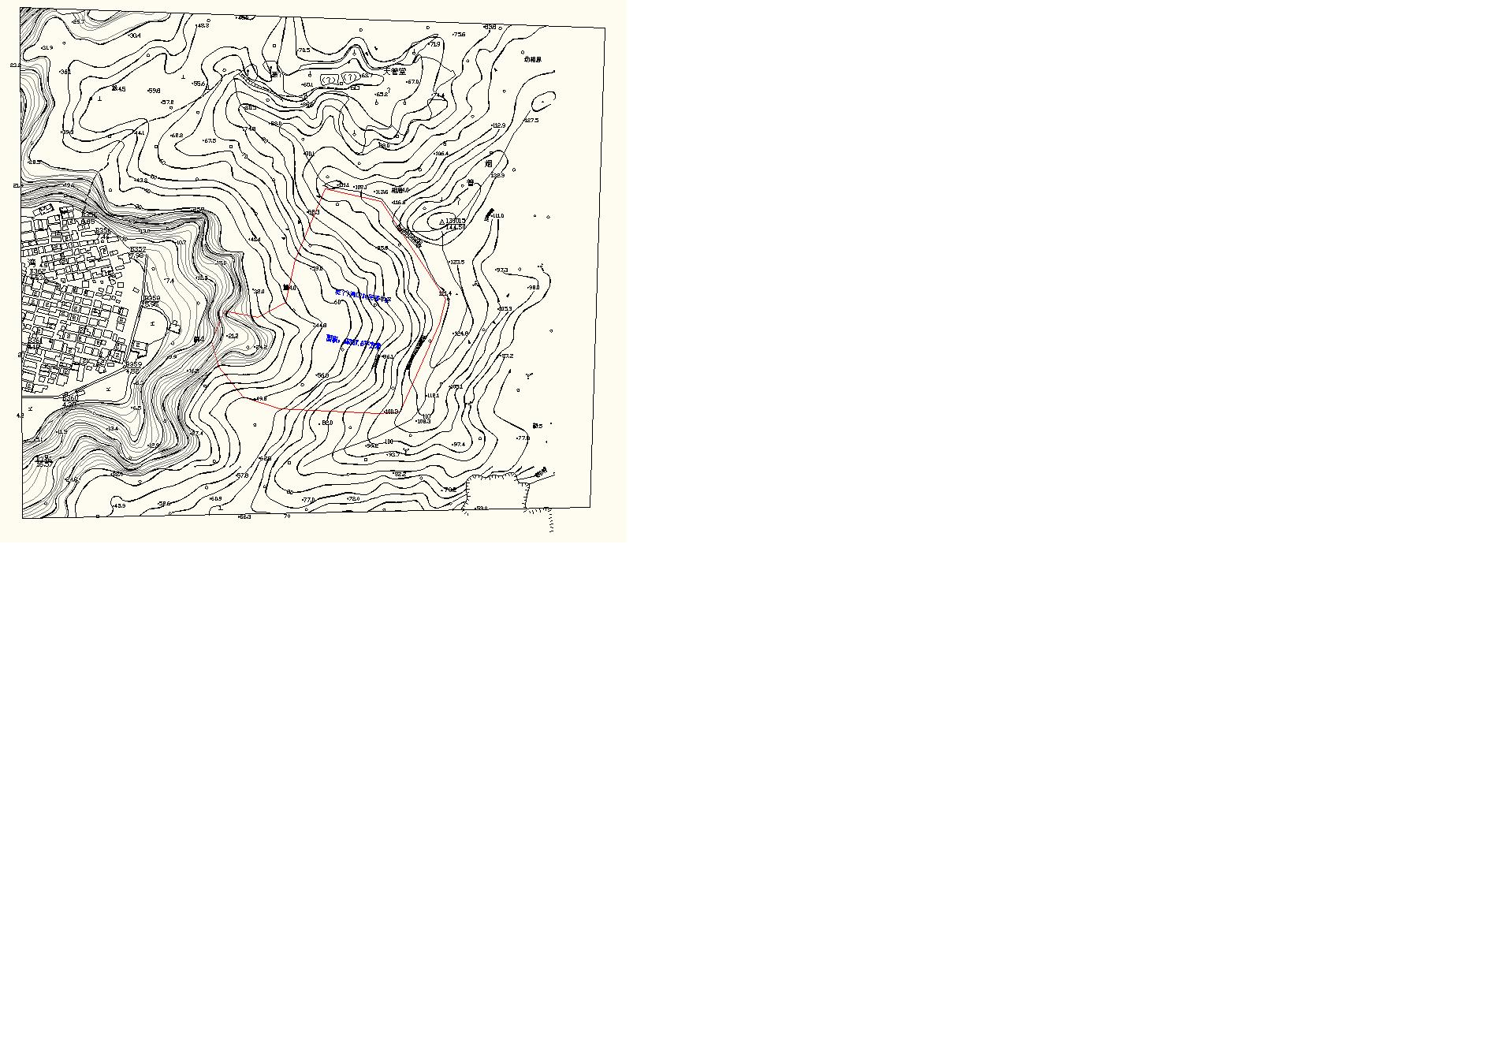
1. Finding Valley-type topography
2. Setting the direction of debris flow and make longitudinal section

Slide 14
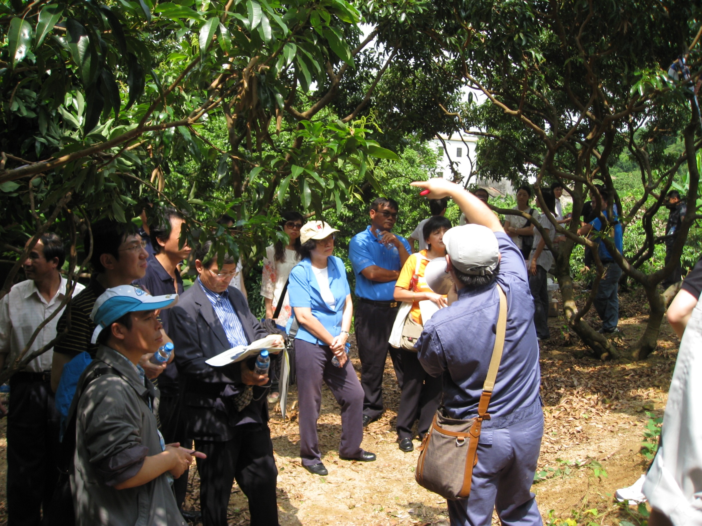
1. Finding Valley-type topography
①
2. Setting the direction of debris flow and make longitudinal section

Slide 15
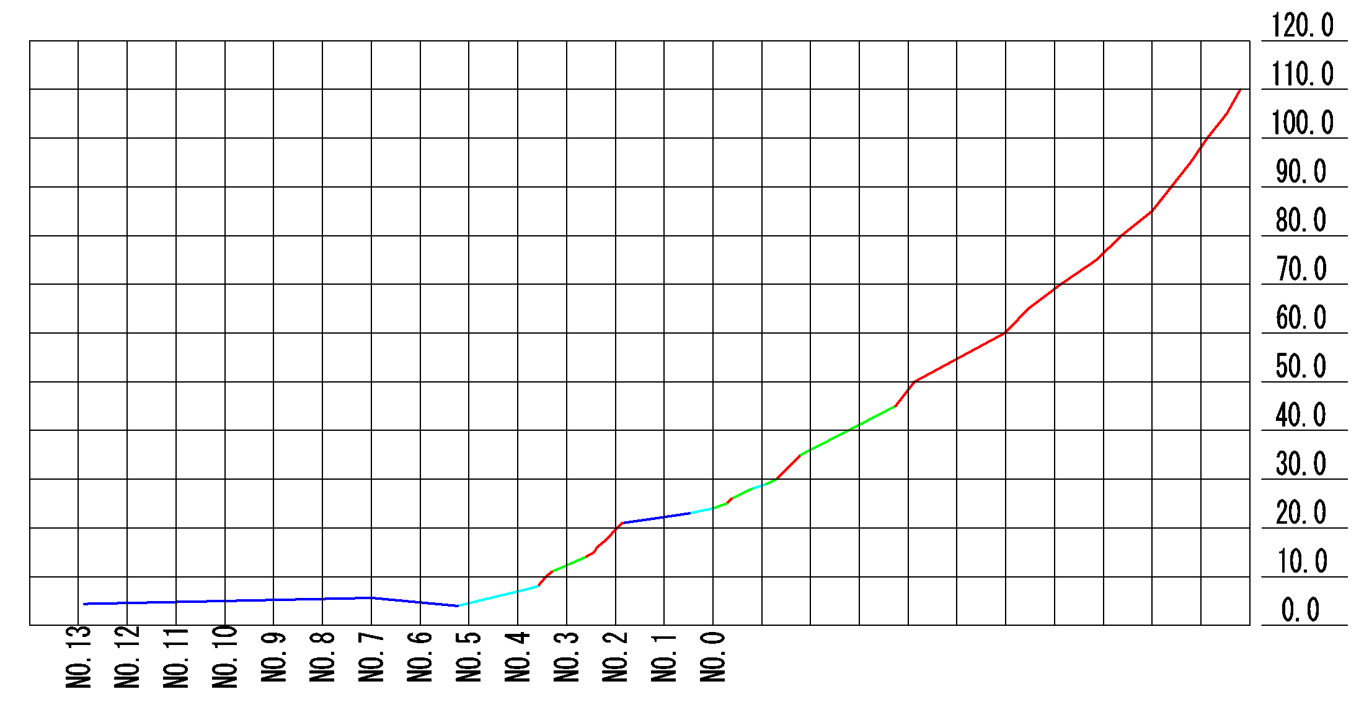
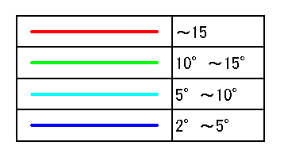
3.Measure gradient of stream and identify the point of that become
10 degree = Flooding beginning point
2 degree = the end of warning area
10 degree
2 degree

Slide 16
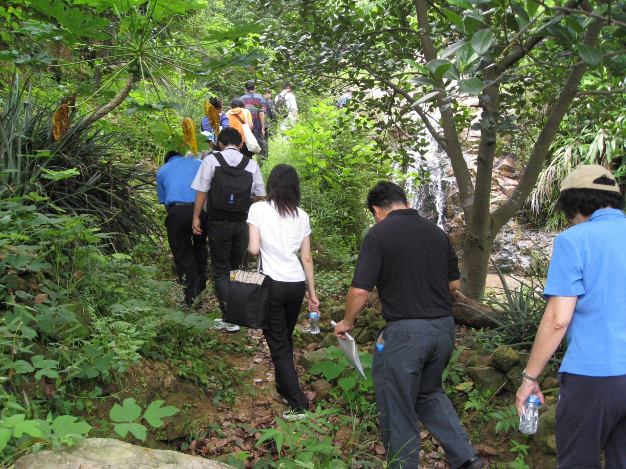
Going upstream to look for 10 degree point

Slide 17
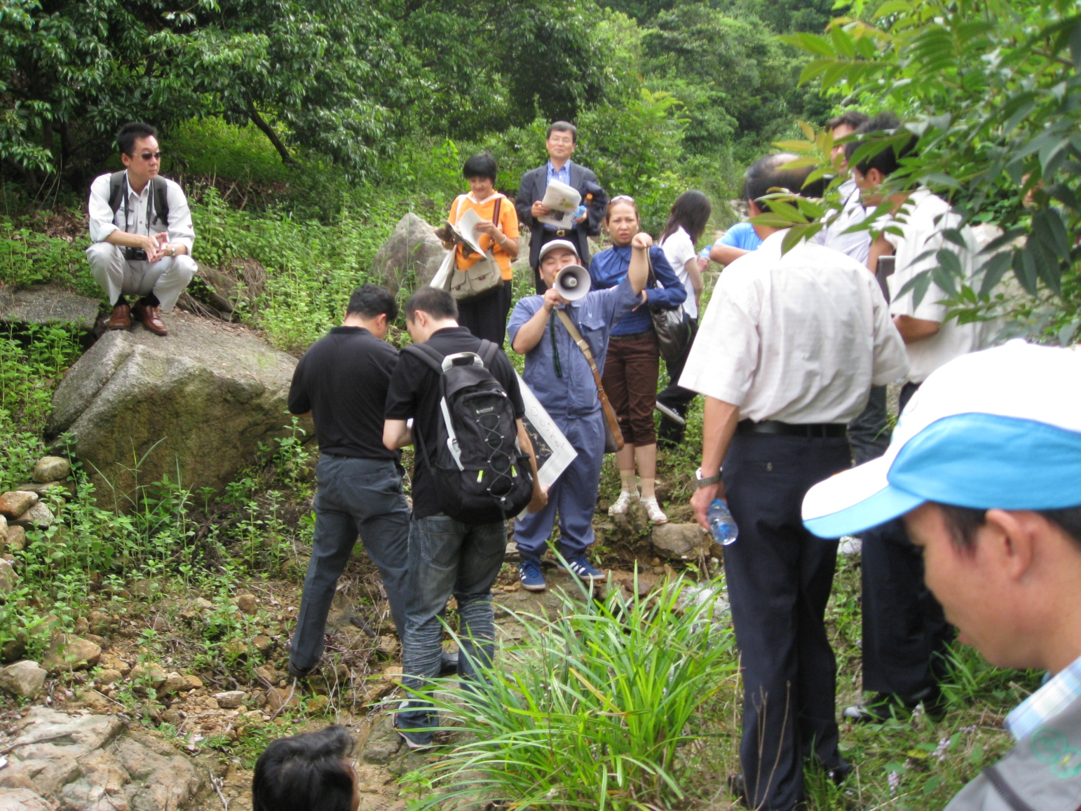
3.Measure gradient of stream and identify the point of that become
10 degree = Flooding beginning point
②

Slide 18
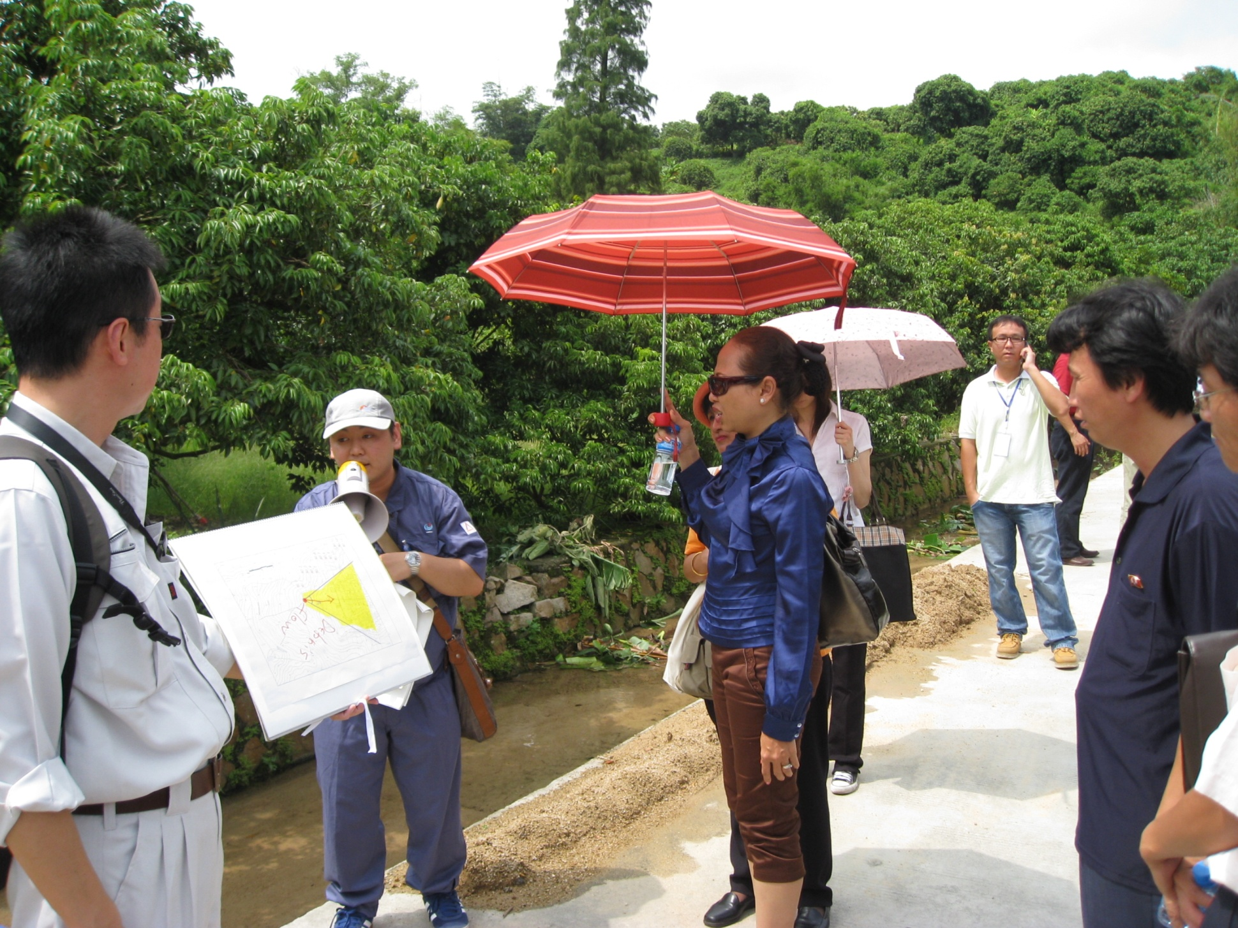
2 degree = the end of warning area
③
4. Draw warning area
with watching
5m above riverbed
in several points
above 5m (image)

Slide 19
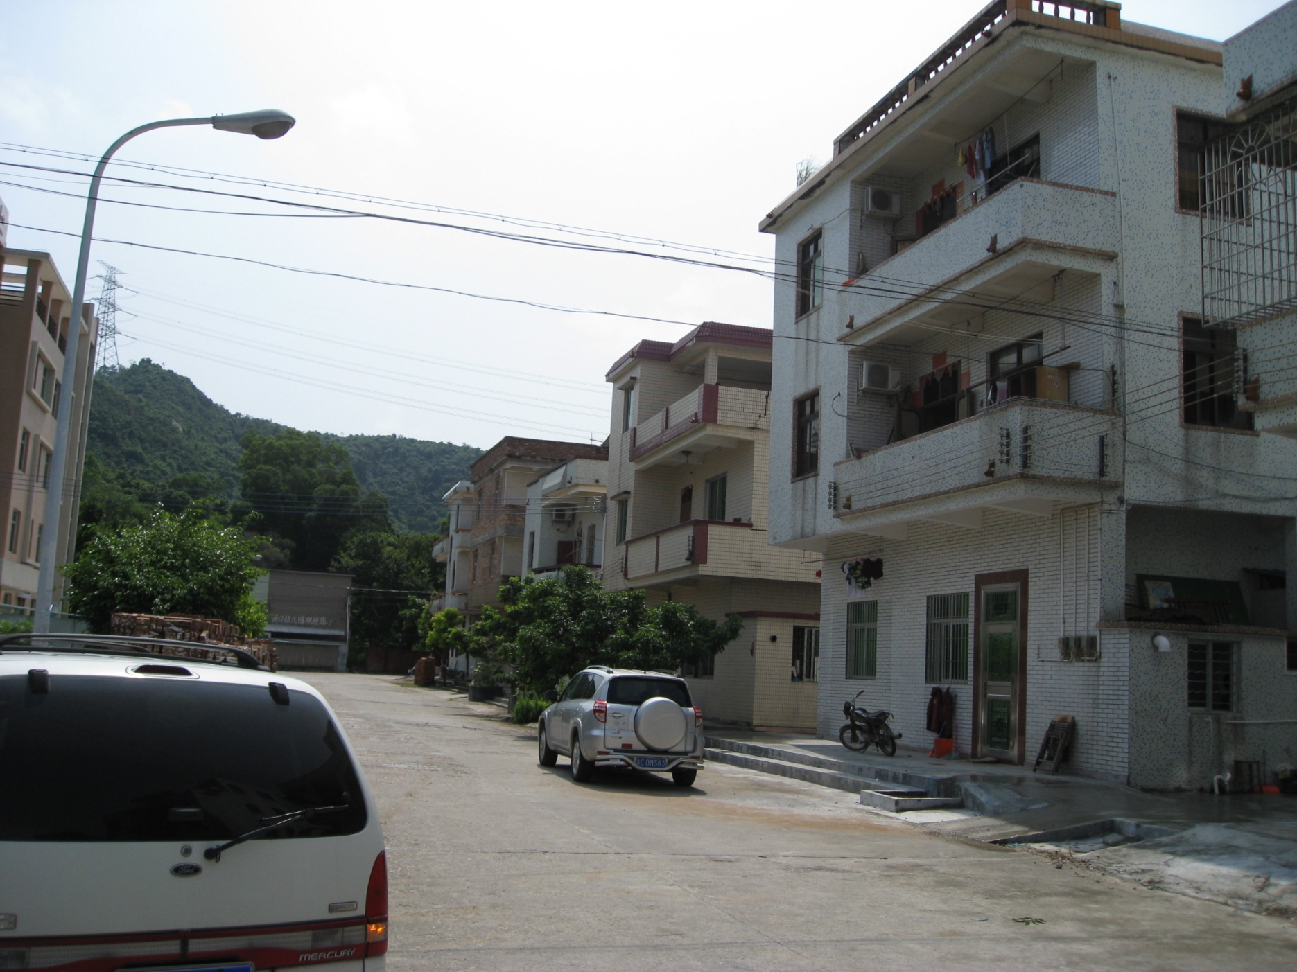
Evacuation route
④

Slide 20
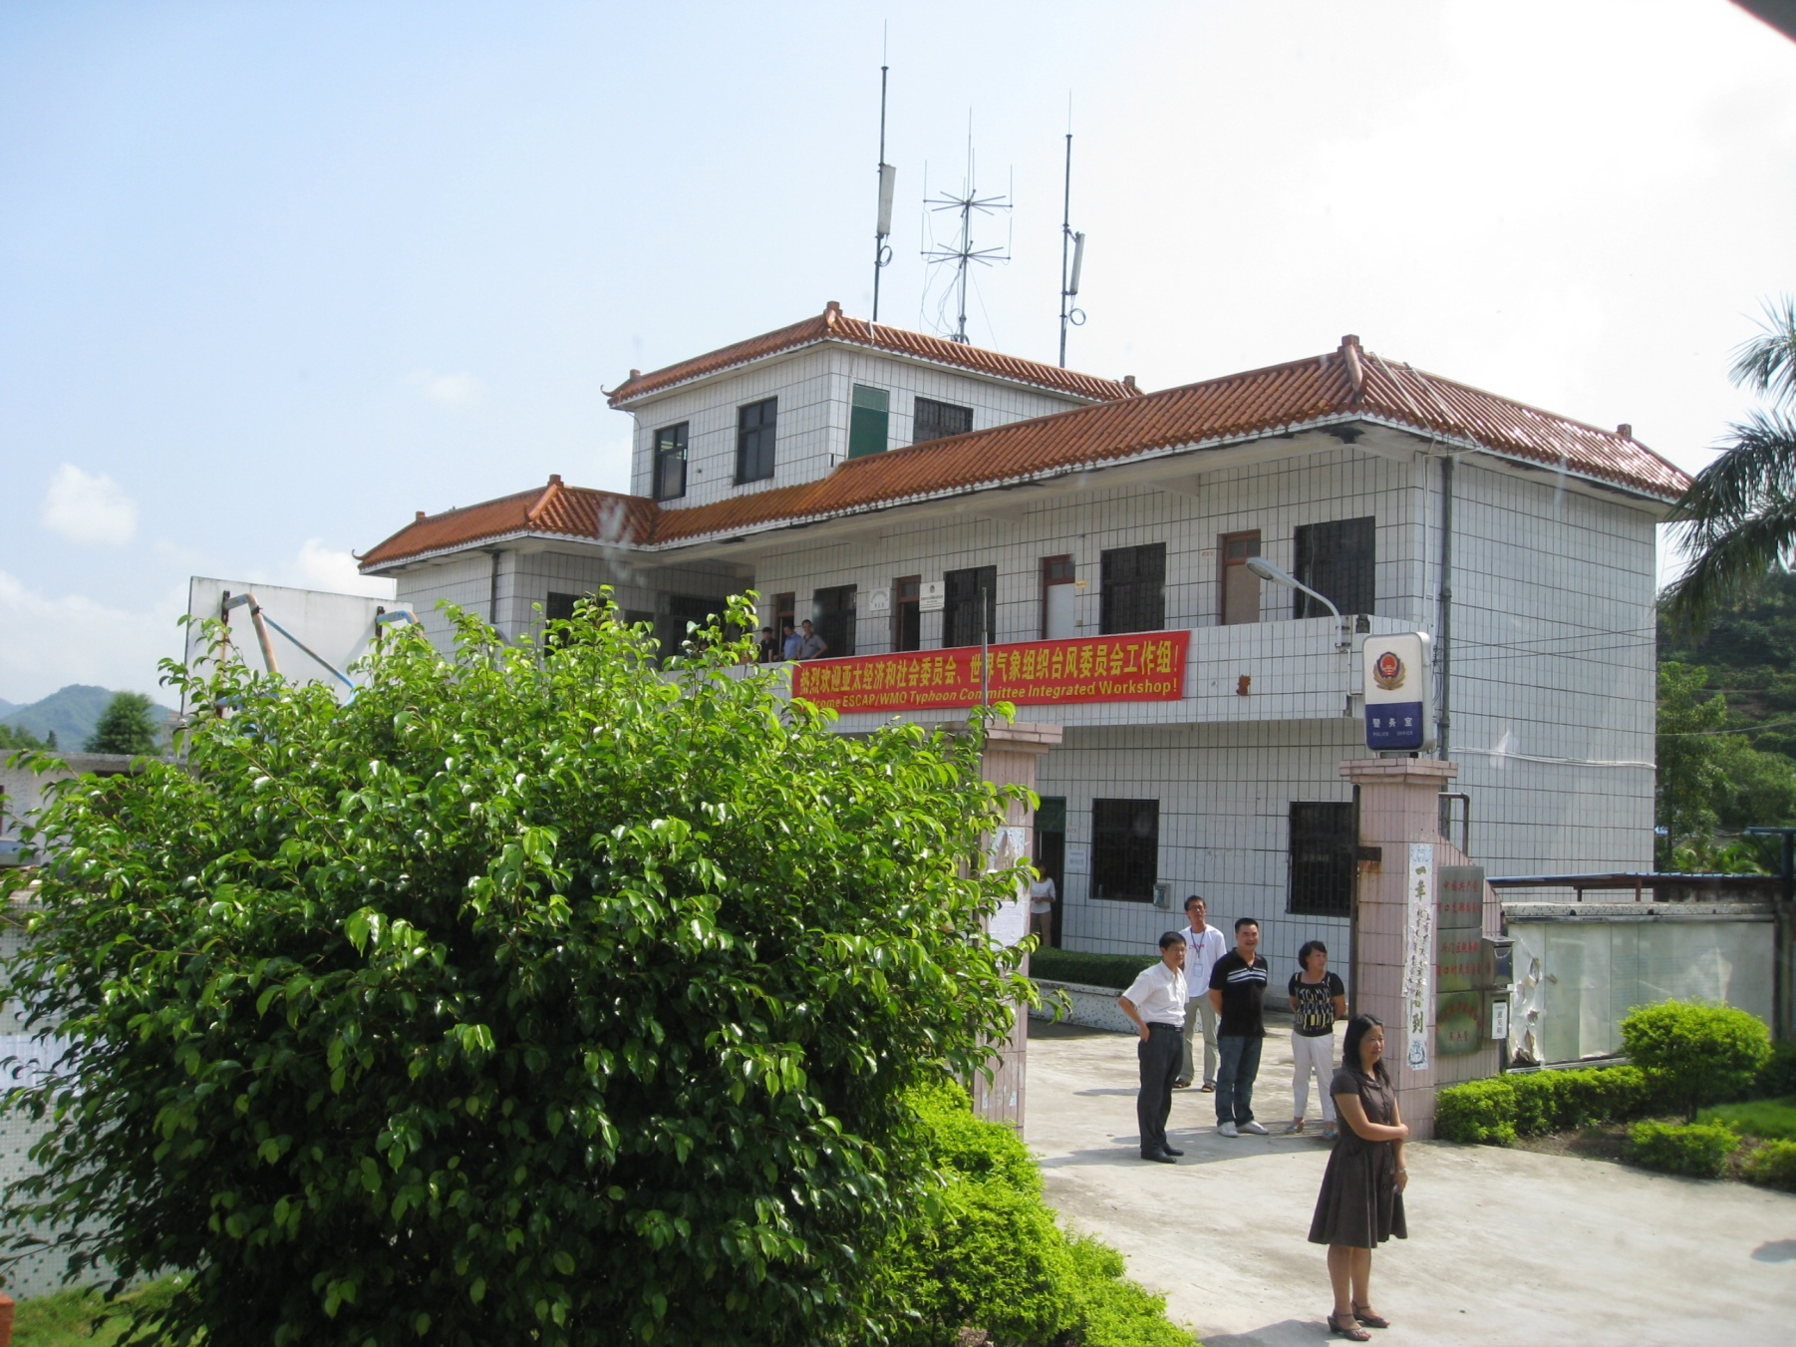
Refuge
⑤

Slide 22
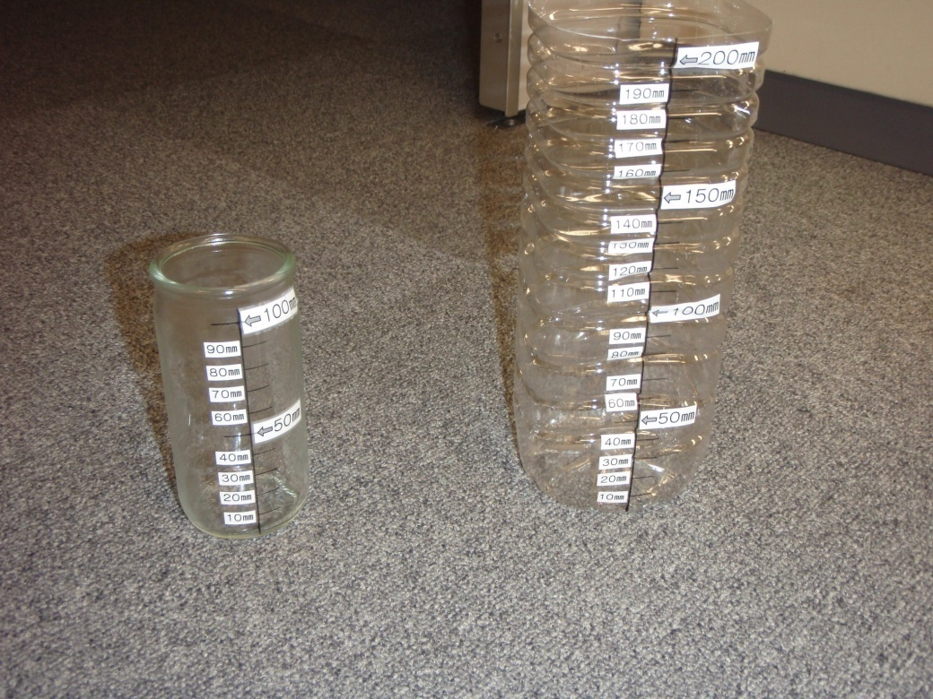
1. When to escape?
Be aware to rainfall
- Caution from Meteorological Bureau
> Announcement by TV, Web, etc.
- Measure rainfall by yourself
> Simple tools also useful
Example of simple tool made by plastic bottle to measure rainfall
****Important****
If you feel “Unusual rainfall!!”,
Don’t hesitate to evacuate!!!

Slide 23
2. Escape from what? where to escape?
○○ village Hazard map for sediment-related disaster
Hazard Map
- what type of phenomena?
- how wide it spread?
- where to escape?
Refuge:
Elementary School
Evacuation route
Notice:
Yellow zone is a high risk area for debris flow.
If It has inexperienced heavy rain, be careful and evacuate.
100m

Slide 24


3. How to be able to escape?
(Preparedness in usual)
Japanese example of evacuation drill
in every June
3.1 Governmental Officers
Who will decide evacuation recommendation to residents?
How to announce evacuation recommendation to residents?
How to manage shelter operation?
Drill for sediment disaster by city officers
Drill to distribute foods and drink for evacuees

Slide 25
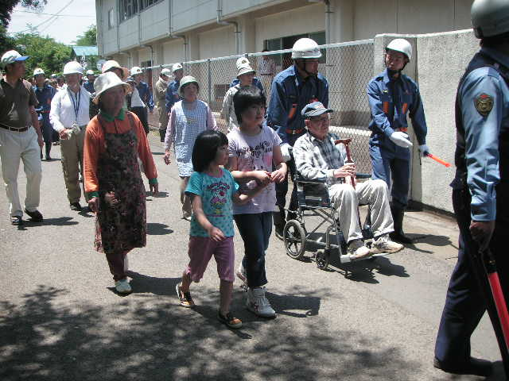
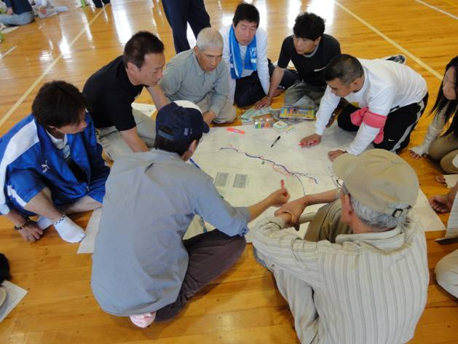
3. How to be able to escape?
(Preparedness in usual)
Japanese example of evacuation drill
in every June
3.2 Residents
Who will take aged people and handicapped people to shelters?
>cooperation in community
How to keep aware to disasters?
>hold seminars, evacuation drill
Drill to take aged people
and handicapped people to shelters
To make handmade hazard map by residents

Slide 26
Road map
1st year (2009)
  Japan will distribute a draft of guideline and opens THD.
  Members select model sites.
2nd year (2010)
  Field training
  Members draw hazardous area in the model sites.
  Discuss technical problems at WS.
3rd year (2011)
  Members make Hazard map that will register in the guideline to reduce damage of sediment‐related disaster.
  Publish the guideline to reduce damage of sediment-related disaster and to spread Japanese technique in Typhoon Committee Region.

Slide 27
Example of Hazard Map:
○○ village Hazard map for sediment-related disaster
Refuge:
Elementary School
Evacuation route
Notice:
Yellow zone is a high risk area for debris flow.
If It has inexperienced heavy rain, be careful and evacuate.
100m

Slide 28
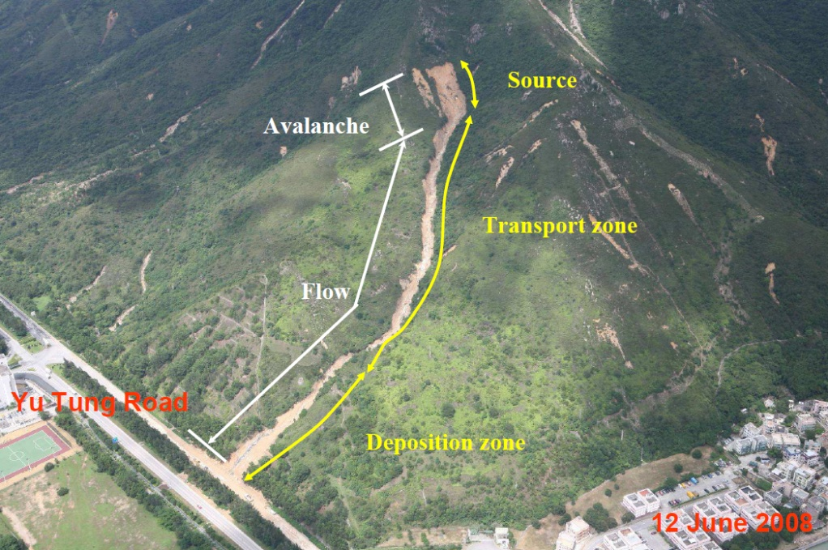
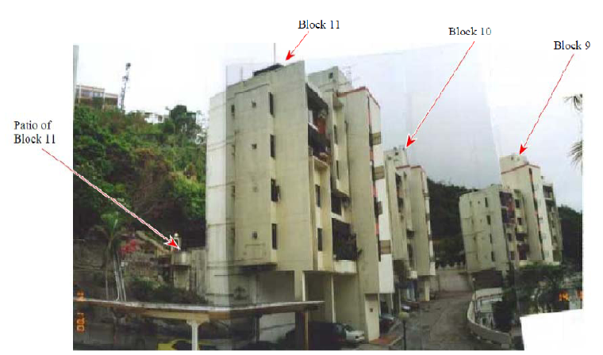
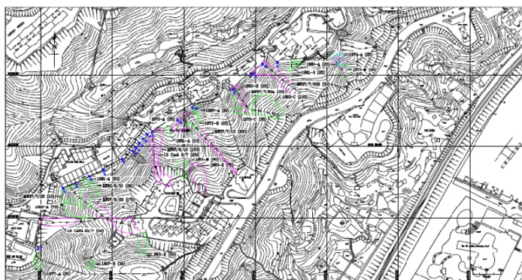
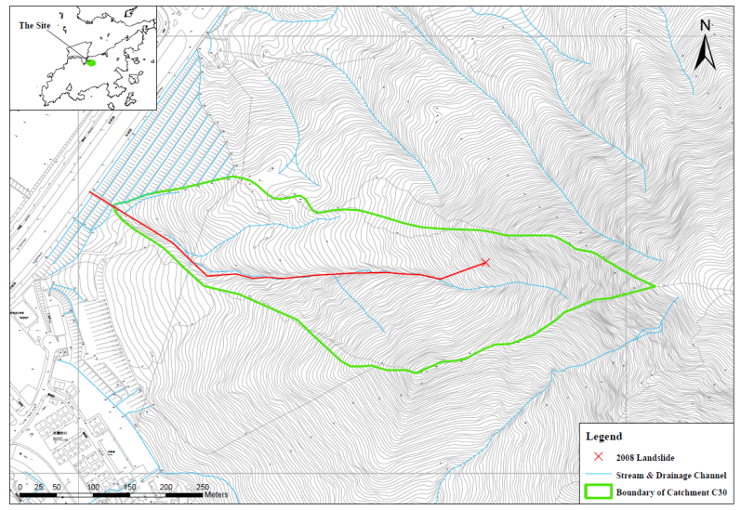
Participating members select model site.
Ex. 1) HongKong China
Debris Flow
Slope failure

Slide 29
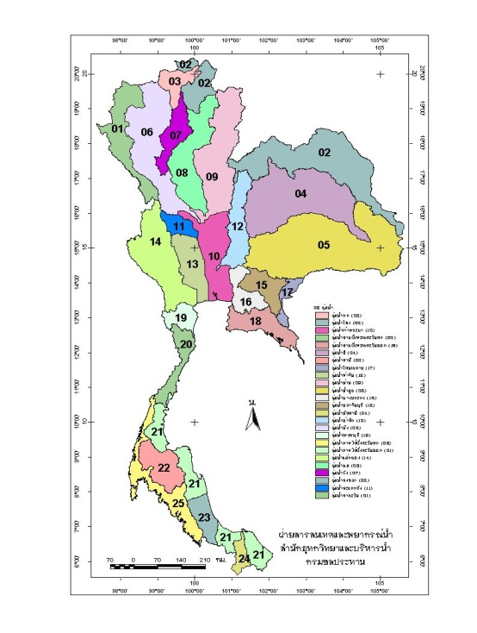
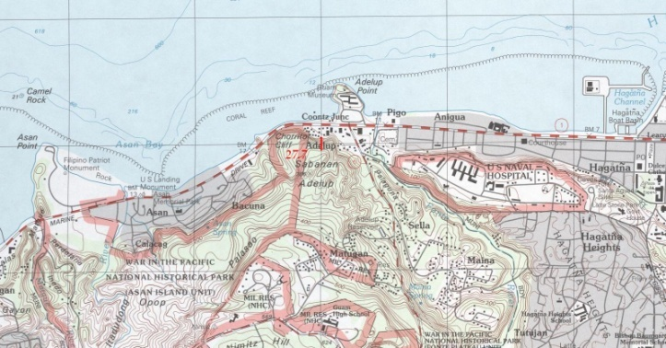
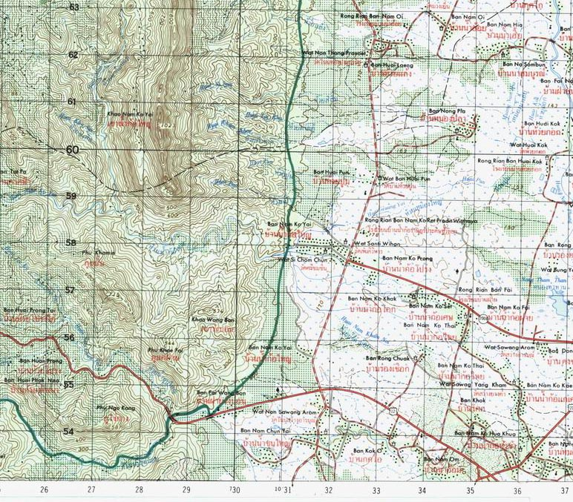
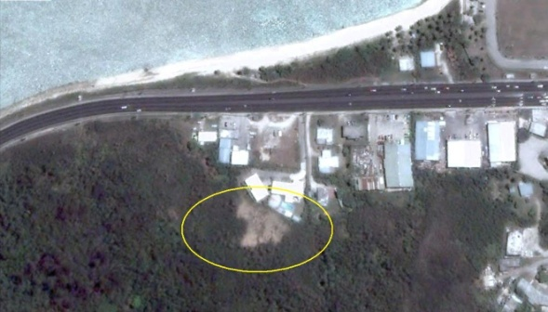
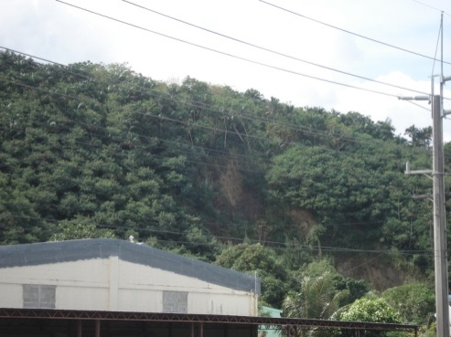
Ex. 2) United States
Ex. 3) Thailand
Slope failure
Debris Flow
Model site
Model site 1
Model site 2
  Participating members will draw hazardous area in the model sites.
  Participating members will make hazard map.

Slide 30
Thank you for your attention!

